Slide 1

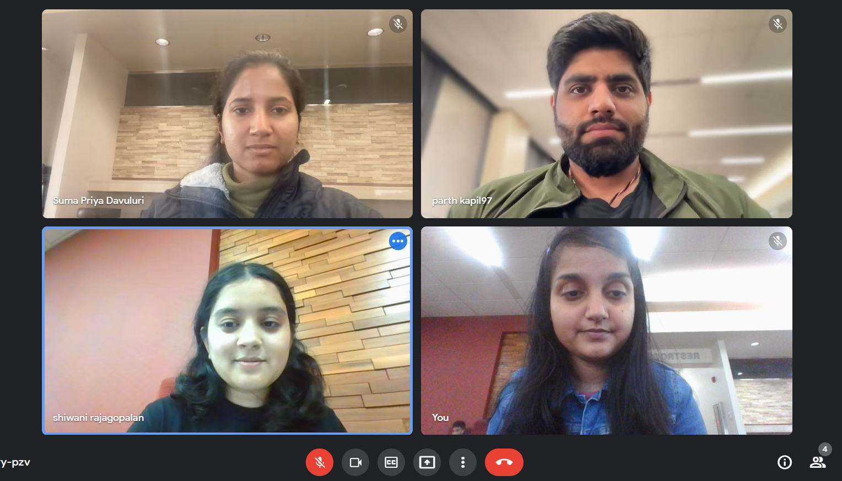
Team Members:
Parth Kapil, Shiwani Rajagopalan, Shubhangi Mishra, Suma Priya Davuluri

Slide 2
Problem Statement
One of the major problems for loan providers today is to find out the applicants who will likely repay loan.
Companies can avoid losses if they can predict loan repayment based on certain information about applicants.
Home Credit Default Risk Prediction is aimed at giving solution to the above mentioned problem.
We run applicant information through several machine learning models and find the model that predicts well.
This project is part of a Kaggle competition and we submit our implementations in the end to get a high Kaggle score.

Slide 3
Phase 1 - Recap
Performed Exploratory Data Analysis (EDA) on the dataset.
Found the missing features, features: numerical and categorical.
Merged data in the order that was described in the Kaggle dataset description.
Built 2 baseline models: Naïve bayes and Logistic regression.
Made a comparison of the 2 models based on the metrics: ROC/AUC, F1 score, Precision, Recall, Log-Loss.
Logistic regression performed well and was taken as the baseline model.

Slide 4
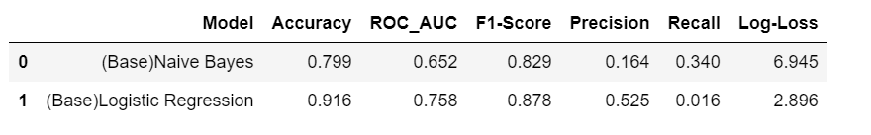
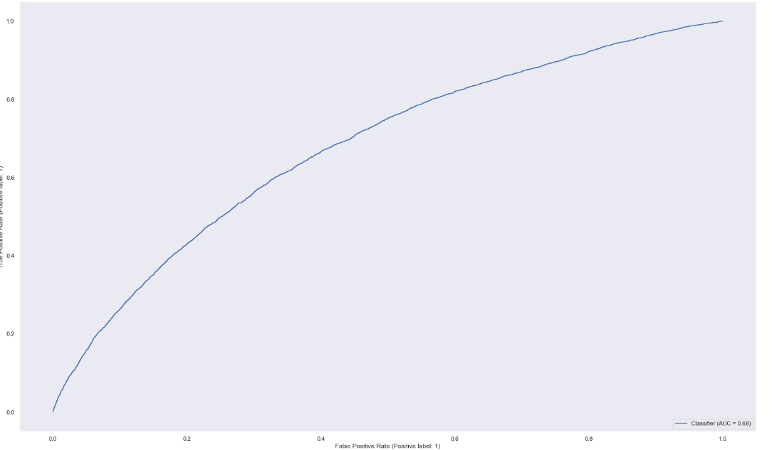
Phase 1 - Results baseline pipelines: Naïve Bayes and logistic regression
ROC curve for Naïve Bayes

Slide 5
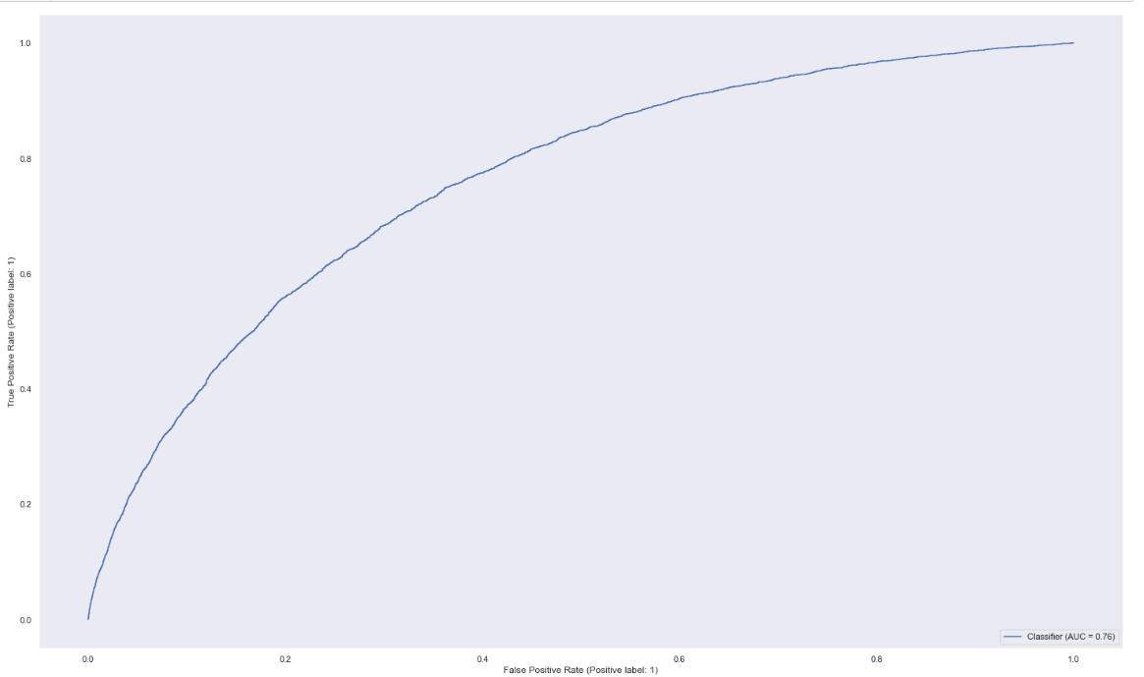
ROC curve for Logistic Regression

Slide 6
Past - Phase 2 (Feature Engineering) - Recap
-Perform one hot encoding
-Performed feature engineering on different datasets to create new features.
-Checked correlation, maintain high correlation between newly created features and target variables.
-Merged all datasets where feature engineering was performed.
-Missing data to be handled during feature engineering by replacing infinity with null values.
-Dropped features which have more than 60% of null data.
-Imputed median for features with less than 60% of null data.
-Data standardized using min-max scaler.

Slide 7
Past- Phase 2 (Hyper-Parameter Tuning) Recap
Logistic Regression:
Parameter: Penalty, C value.
best parameter:{'lr__penalty': 'l2', 'lr__C': 1000}
ROC/AUC score: 0.77
SVM:
Parameter: C value, kernel, gamma, and degree (as polynomial is used as a kernel).
best parameter:{'svm__kernel': 'rbf', 'svm__gamma': 0.01, 'svm__degree': 2, 'svm__C': 1}
ROC/AUC score: 0.75
Random Forest:
Parameter: estimators, max_features, max_depth, criterion
best parameter:{'rf__n_estimators': 500, 'rf__max_features': 'log2’, 'rf__max_depth': 5, 'rf__criterion': 'entropy'}
ROC/AUC score: 0.73

Slide 8
Past - Phase 2 (Hyper-Parameter Tuning) Recap
XGBoost
Parameter: xgb__learning_rate, xgb__max_depth, xgb__min_child_weight.
Best parameter: {'xgb__min_child_weight': 1, 'xgb__max_depth': 7, 'xgb__learning_rate': 0.1}
ROC/AUC: 0.77
Naïve Bayes
Parameter: alpha
Best parameter: {'nb__alpha': 1}
ROC/AUC: 0.65
Compared the models mentioned above using the metric: ROC/AUC, F1 Score, Log-Loss, Precision and Recall.
XGBoost performed well when the ROC/AUC score was compared for all the models used.

Slide 9
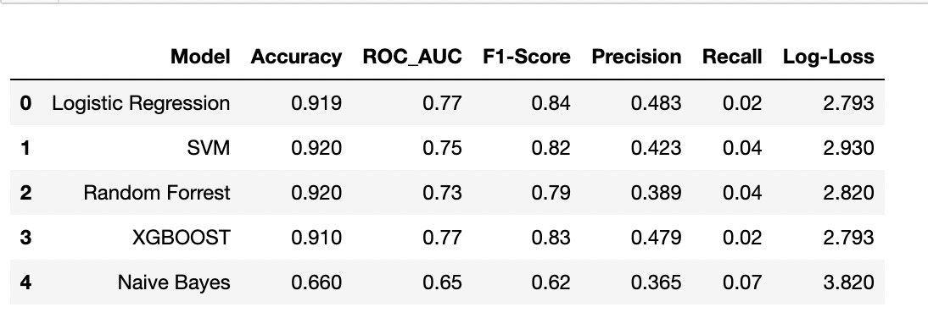
Results

Slide 10
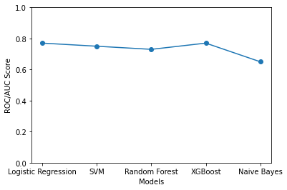
ROC/AUC Score

Slide 11
Present – Phase 3 (MLP)
In the current phase, we have built a Multi Layer Perceptron using Pytorch.
Our implementation contains 3 hidden layers apart from the input and output layer.
Each hidden layer contains 256, 128, and 64 neurons respectively.
The activation functions used in the hidden layers are sigmoid.
Numpy array is converted to pytorch.

Slide 12
Present – Phase 3 (MLP)
For optimization, we have used Stochastic Gradient Descent (SGD) and log-loss has been used to calculate loss.
Learning rate used here was 0.01 and the number of epochs are 500.
Early stopping was implemented in training.
Model was tested on cross-validation data.
The public score achieved after making a Kaggle submission was 0.58161.
Finally, we visualized the results using tensorboard.

Slide 13
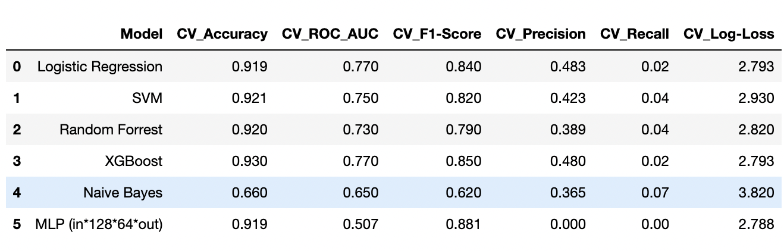
Present – Phase 3 (MLP) Results

Slide 14

Present – Phase 3 (MLP) Kaggle Scores

Slide 15
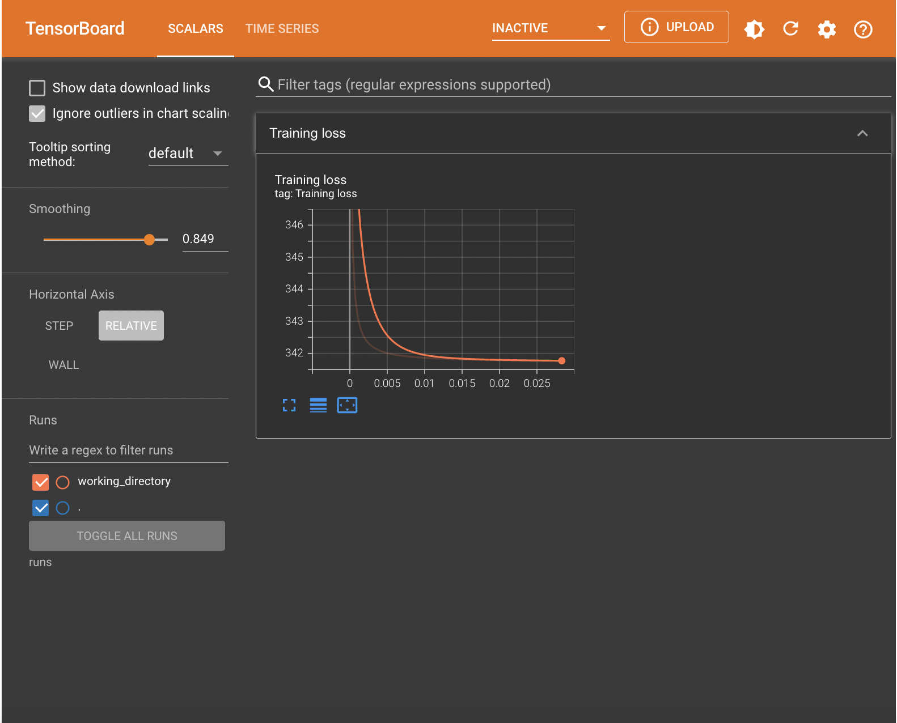
Present – Phase 3 (MLP) TensorBoard Visualization

Slide 16
Problems faced in phase 3:
Running time was longer because the dataset size was huge.
Our MLP model had an ROC/AUC score of 0.56 which was not that great as compared to the XGBoost model that performed well which had an ROC/AUC score of 0.77.
One of things that may have reduced the ROC/AUC score of MLP model may have been our choice of learning rate.
Another thing could have been the data that we obtained after feature engineering (i.e) some important features may have been missed out since we had dropped any features that had greater than 60% of null values.
If given more time, we would have tried to revisit all of these to get some insight into what may have reduced the ROC/AUC scores of our MLP model.

